Slide 1
Capstone final assignment presentation

Slide 2
Business Problem
Travel companies are always in a search to provide best services in order to charge good amount of money to the customers by taking them to the particular food joints they have tie-ups with. Now this does not necessarily mean that those food joints serve the best variational food. To simply put it, local people know more(better) about the place/neighbourhood food than the travel agency "claim to know". So, the problem is how to determine these places in the neighbourhood?

Slide 3
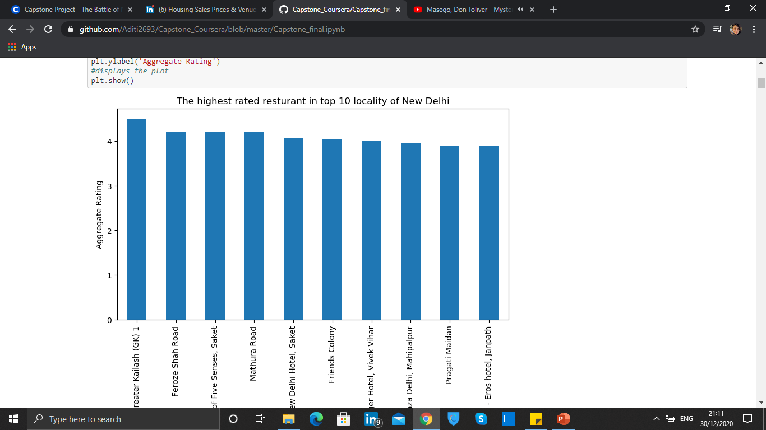
Top 10 locality with highest rated restaurants

Slide 4
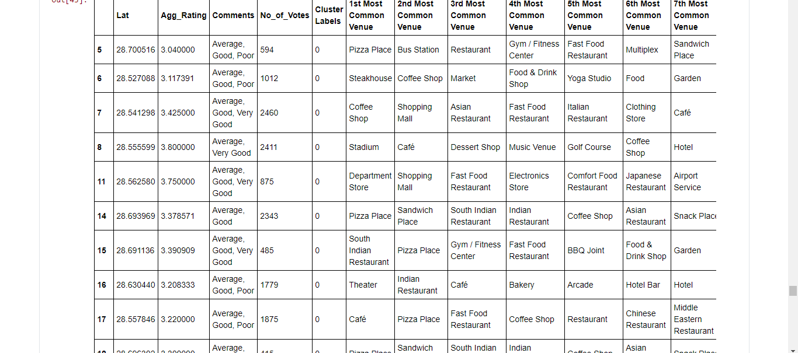
Most common place visited was Pizza Place

Slide 5
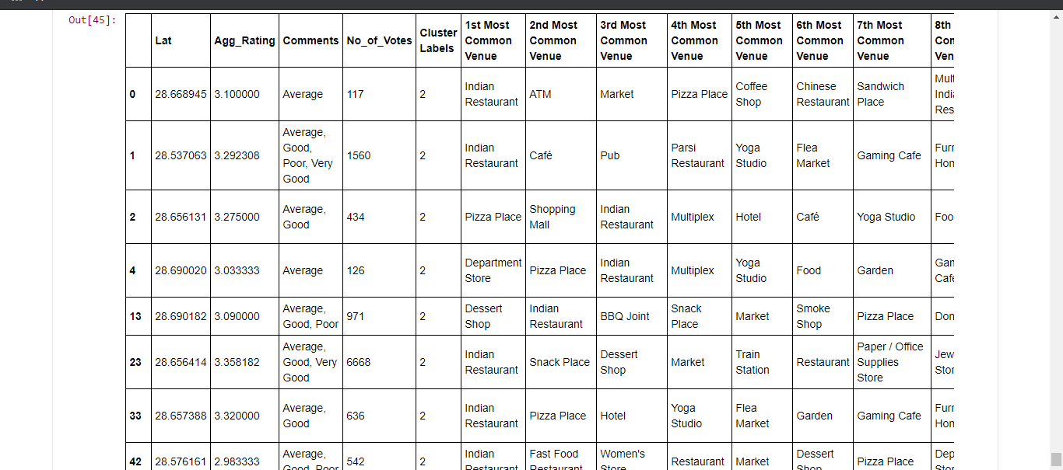
Most rating received by was Indian restaurant

Slide 6
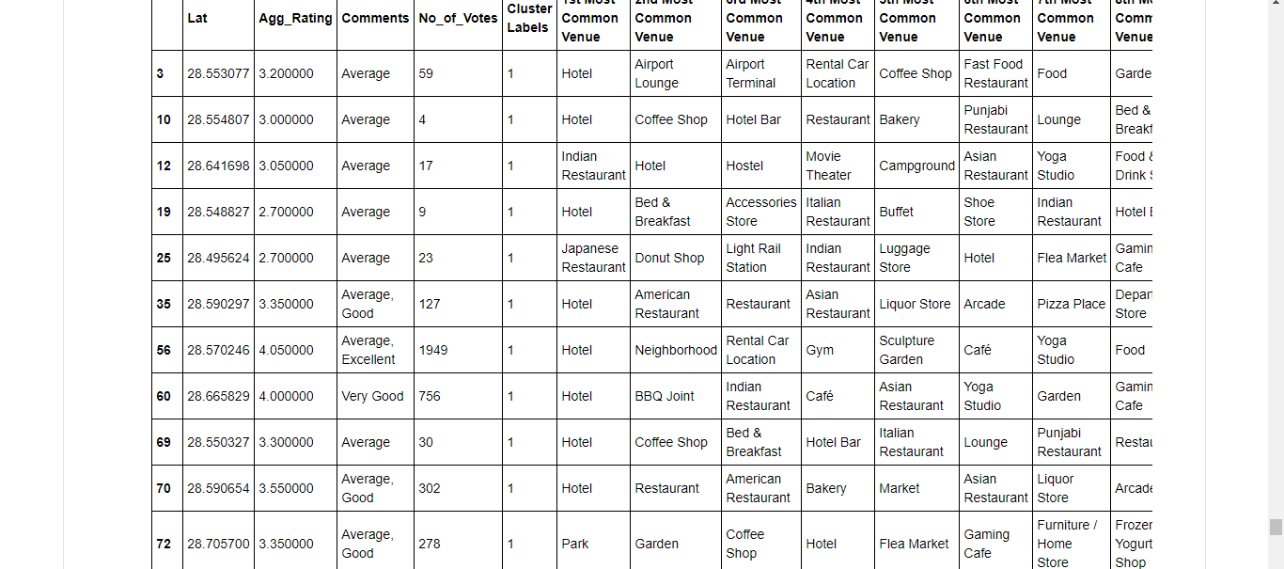
Most number of votes were received by Hotels

Slide 7
Conclusion-
Greater Kailash, Feroze shah road, Saket and Mathura have best rated restaurants in New Delhi.
Most recommended places considering ratings for the restaurants, Pizza places are more popular.
Hotels and Indian restaurants are the second most popular choice.

